Slide 1
GUB HOSTEL PORTAL
Presented to:
Md. Nayan Ali
Lecturer Dept. of CSE
Green University of Bangladesh
Presented by:
Md. Sabbir Hossain
Id: 221902126

Slide 2
1
Content
Introduction
Part of the project
Diagram
Login System
Portal System
Project developing
Advantage
limitation
Reference

Slide 3
2
Introduction
A hostel Portal system is software for managing various activities in the hostel like student information, room information, mess bills, room allocation details and fee details.

Slide 4
3
Part of the Project
Admin Panel
User Panel

Slide 5
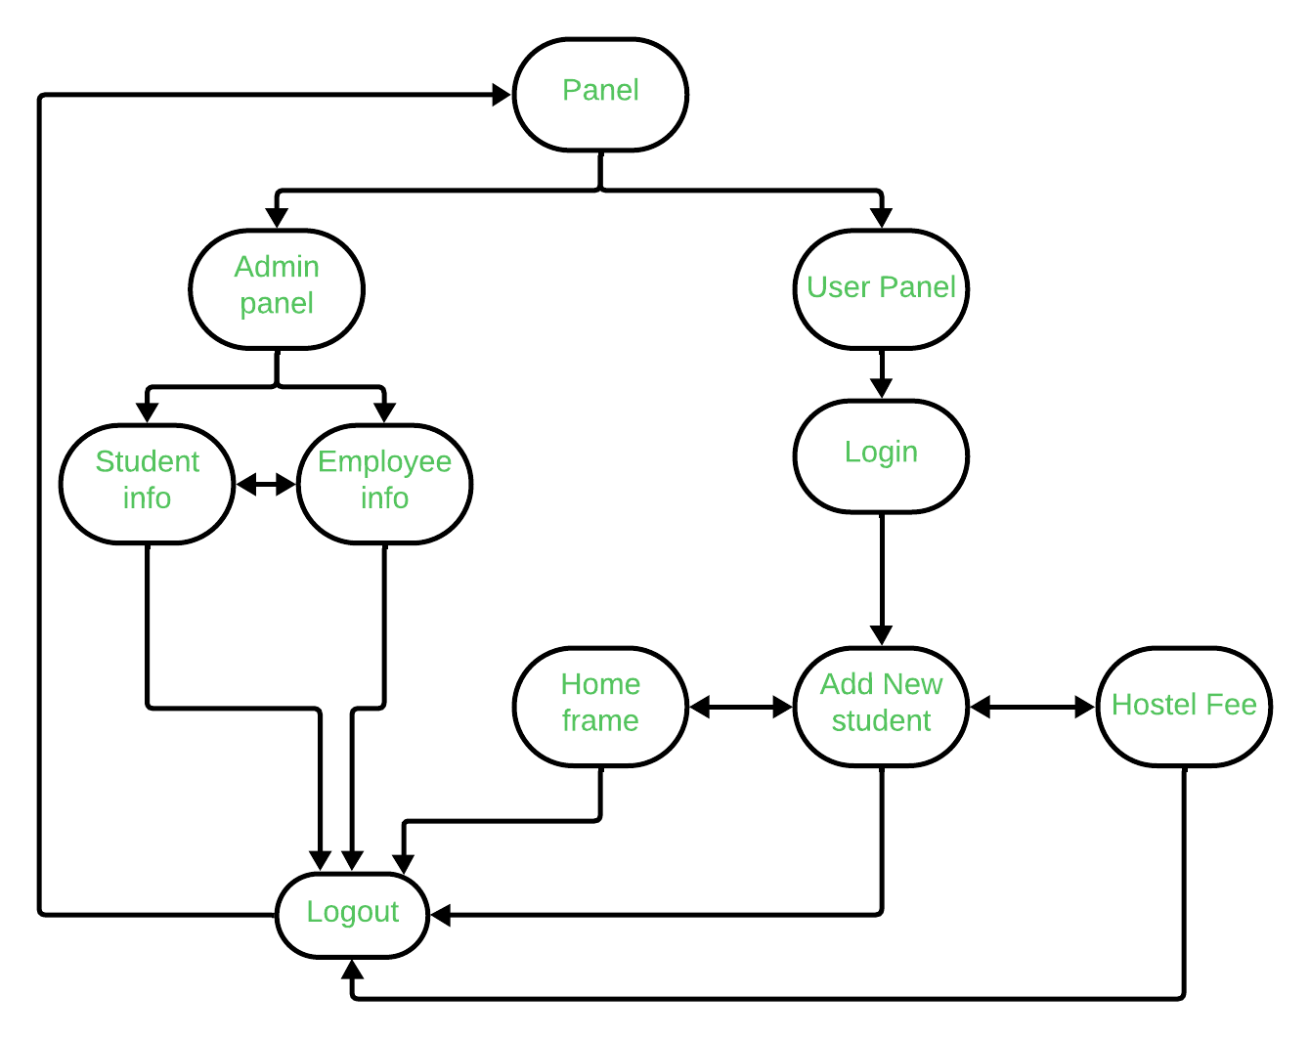
4
Flowchart Diagram
Start
Exit
Figure : flowchart diagram

Slide 6
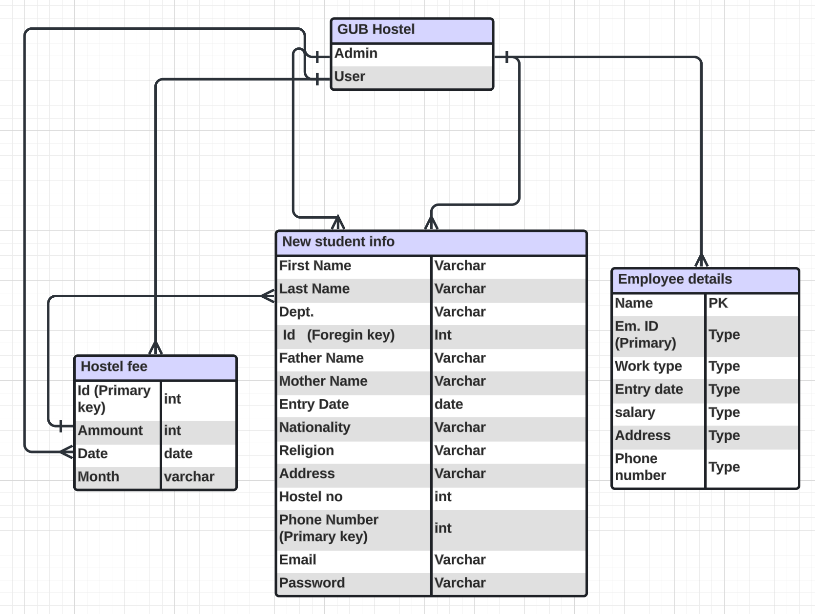
5
ER Diagram
Figure: ER Diagram

Slide 7
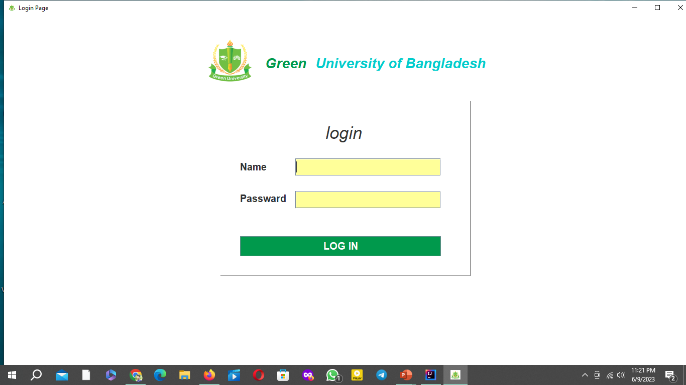

6
Login System
Login system is the procedure used to get access to an application.
Figure 1: Login page

Slide 8
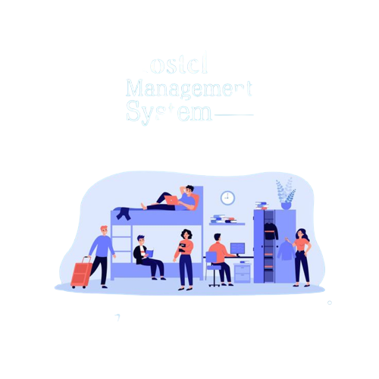
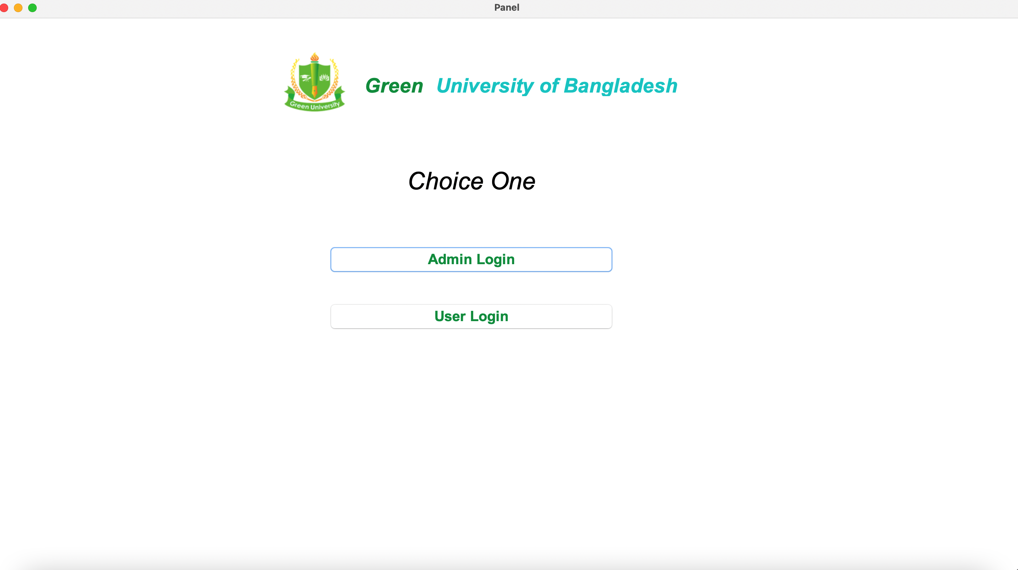
7
Portal System
Figure 3.2: Hostel
Figure 3.1: Home page

Slide 9
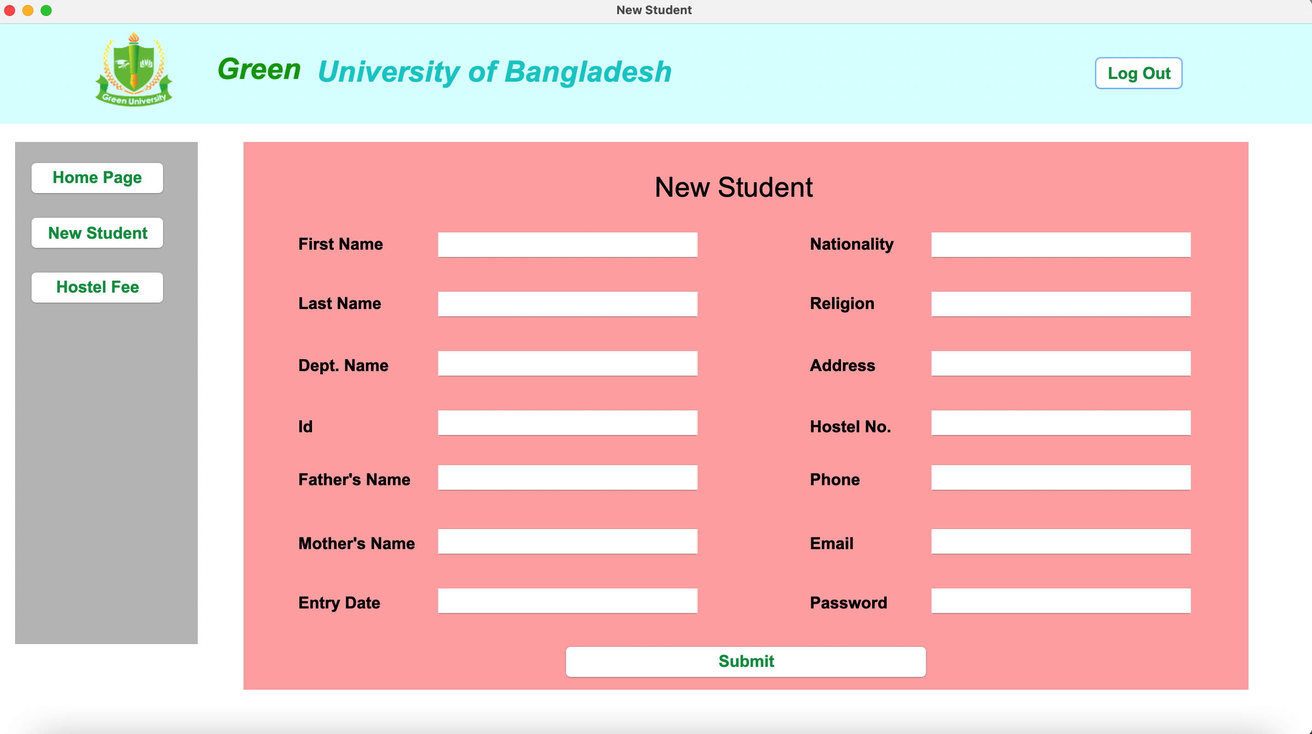

8
Portal System
Figure 4.2: Add student
Figure 4.1: New Student

Slide 10
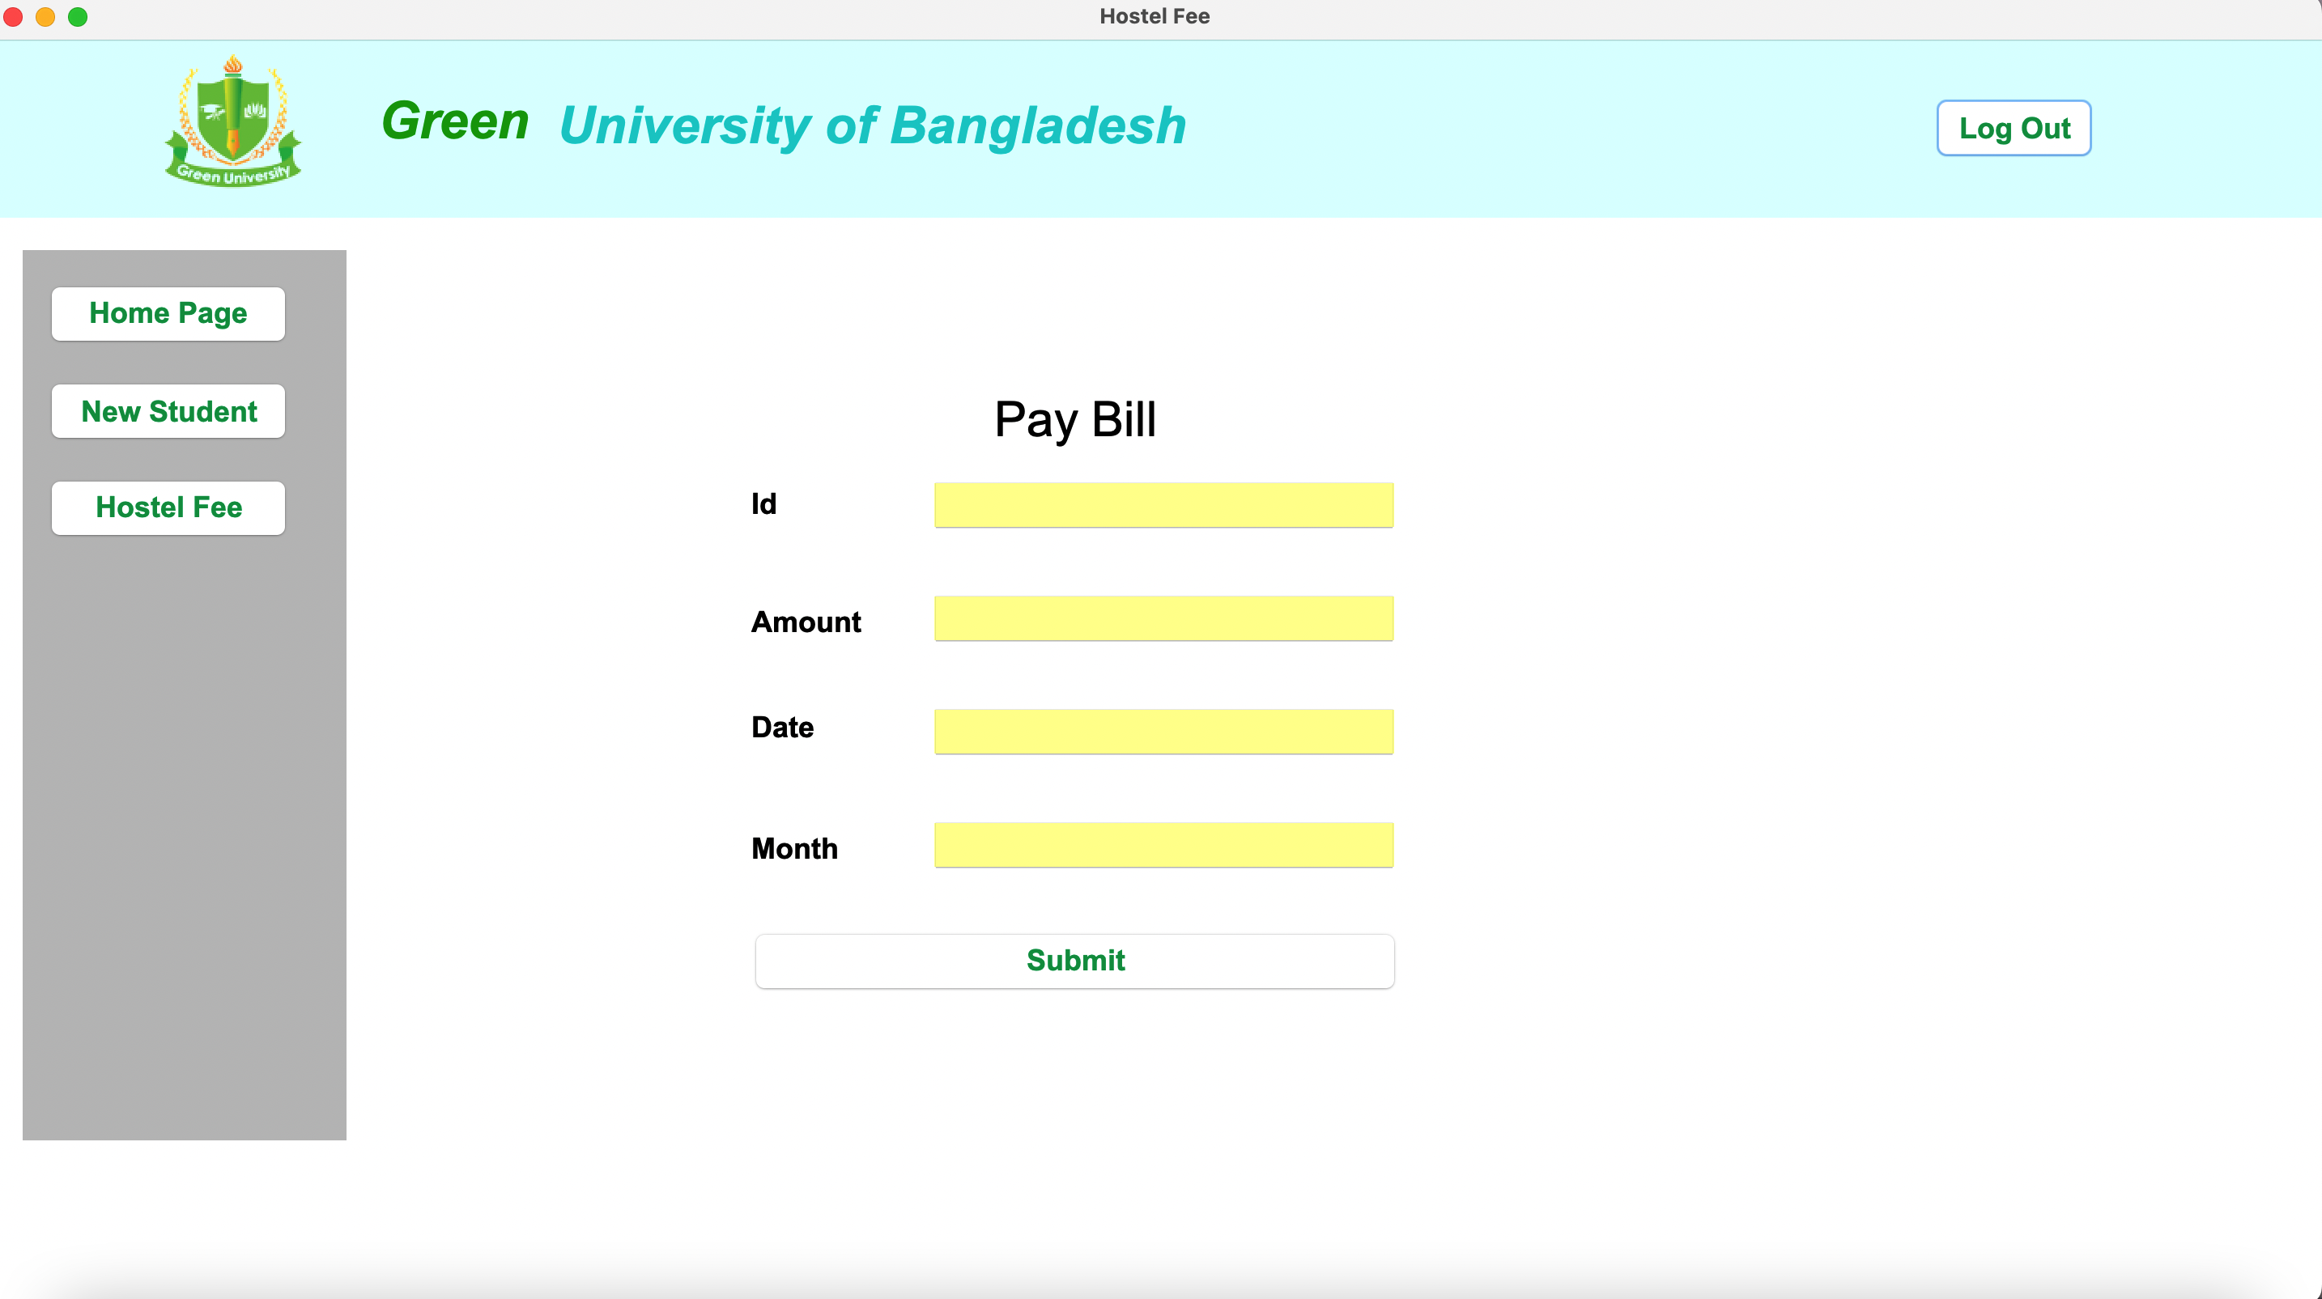

9
Portal System
Figure 5.2: Fee
Figure 5.1: Hostel fee

Slide 11
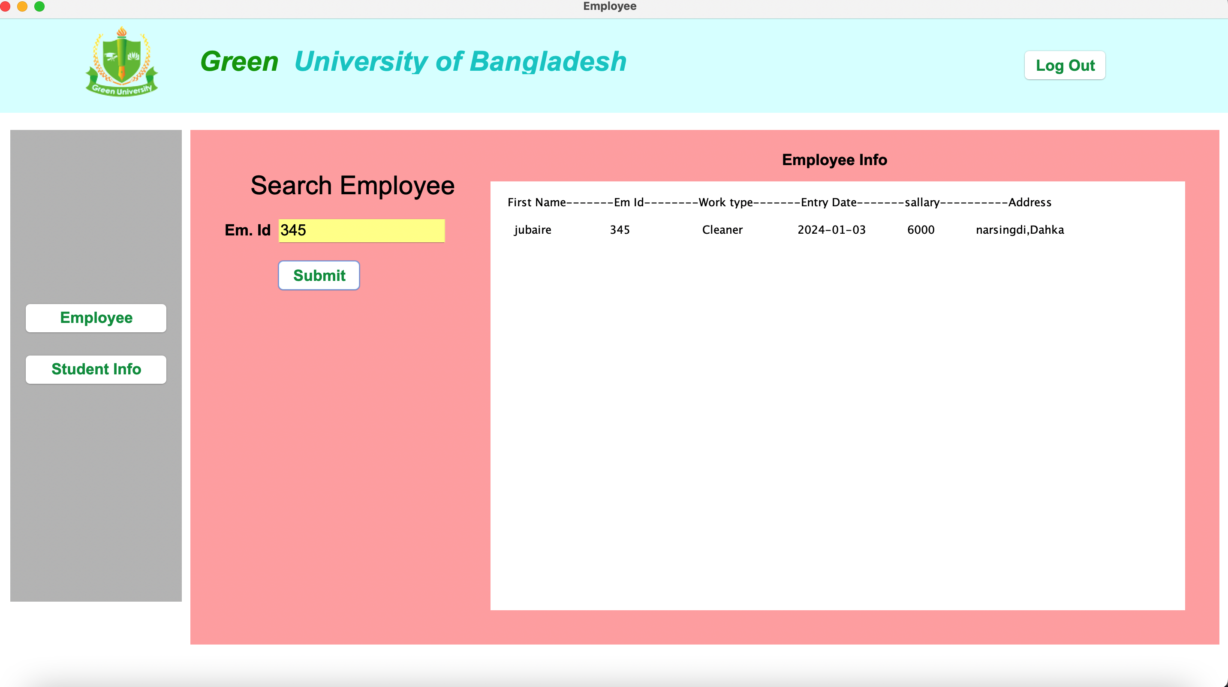

10
Portal System
Figure 6.2: rules
Figure 6.1: Employee details

Slide 12

11
Portal System
Figure 7.1: new student details

Slide 13
12
Project Developing
Database and table Creation
Value insertion
Joining Operator
Triggering Operator
Primary and foreign key
Java Swing for GUI
Xampp server

Slide 14
13
Advantage
It has many advantage :
Student can’t face any problem to pray their hostel fees.
New students will know the hostel facility.
Student will also know security system of hostel portal.
Admin panel don’t get hassle.

Slide 15
14
limitation
It has some Limitation :
String limitation
Graphical User limitation like string and integer text fill.
Student can not see their details

Slide 16
15
Reference
Anisul Islam YouTube
https://www.youtube.com/@anisul-islam
GeeksforGeeks
https://www.geeksforgeeks.org
Javapoint
https://www.javatpoint.com/java-swing
W3School
https://www.w3school.com

Slide 17
Thank You

